Slide 1
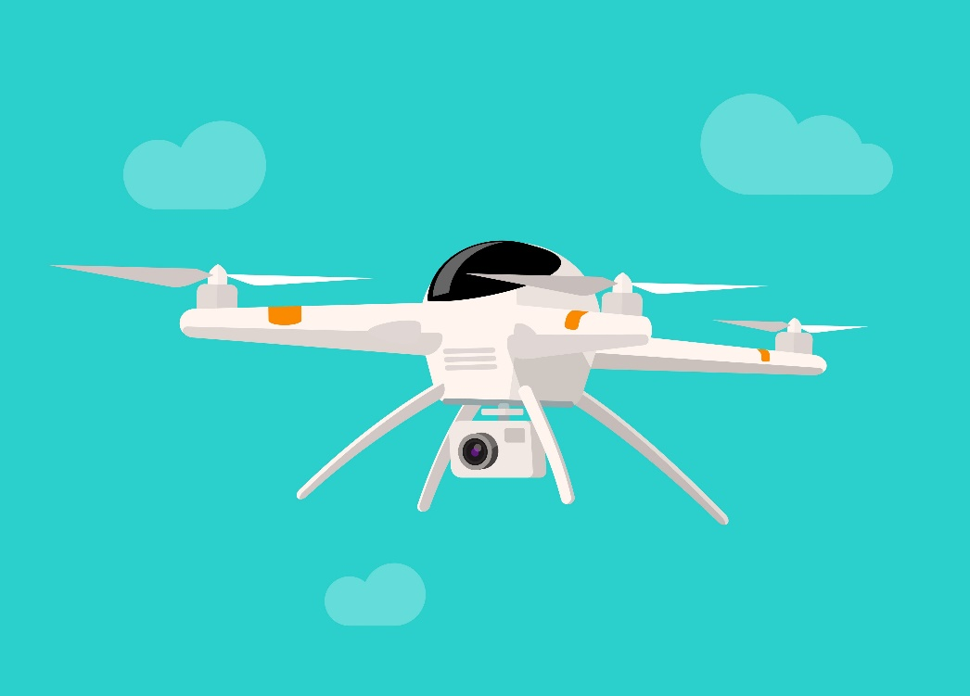
SSDD
Surveillance and Social Distancing Drone

Slide 2
CURRENT PROBLEM

Slide 3
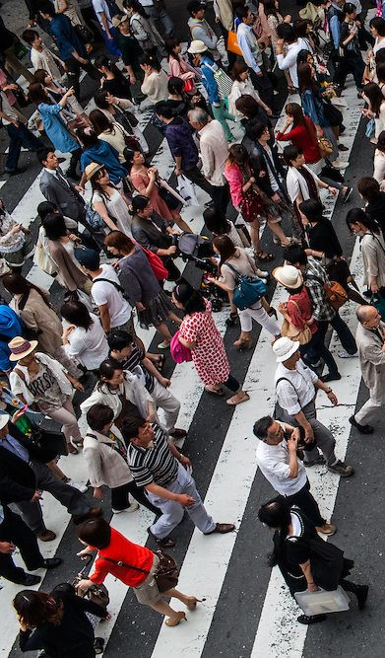
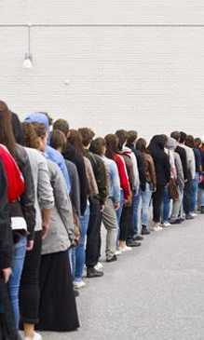
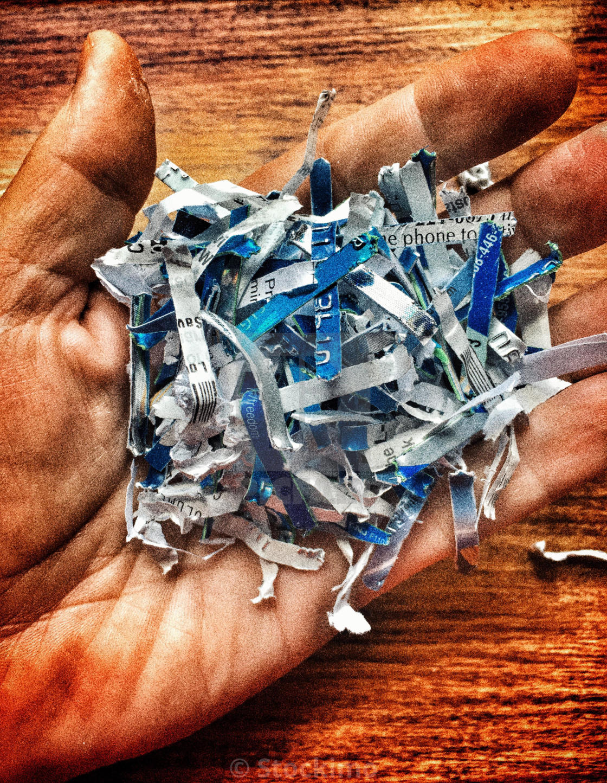
1.4
62
12
days
lakhs
lakh
people
affected by
COVID-19
pandemic in
India.
of
effective
Lockdown
In India.
Frontline Workers
fighting this
deadly
disease.

Slide 4
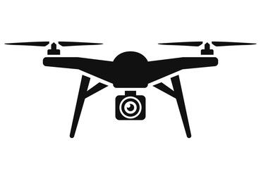
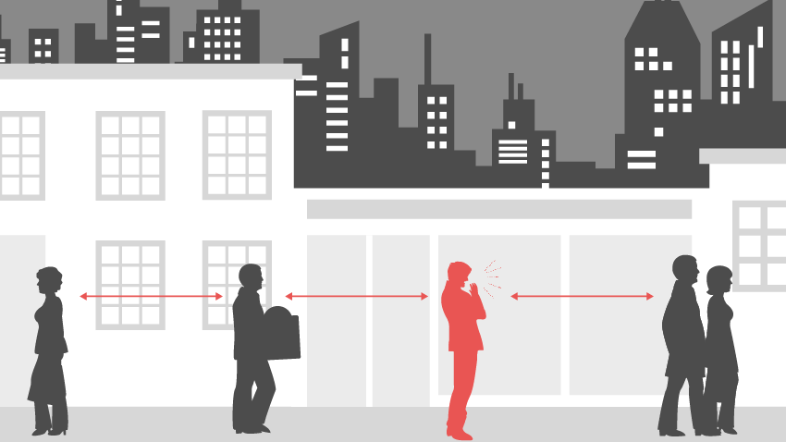
SSDD
A drone for helping and alerting authorities fight COVID-19 by monitoring the public spaces to make people follow social distancing norms using OpenCV(yolo_v3).
Notes:
presenting Face Tag, a facial recognition for Smoother Journeys through Public Transportation Systems

Slide 5



Our Process
Check for number of persons
Object Identification through YOLO_v3
Send an alert to the authorities with the image.png and the log.csv file
Create a log file and take a screenshot if the number of people in a frame is greater than specified

Slide 6
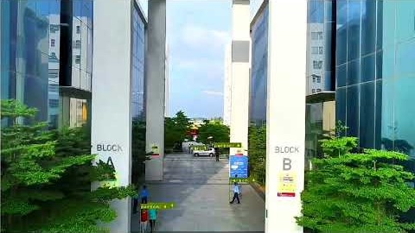
Our Solution

Slide 7
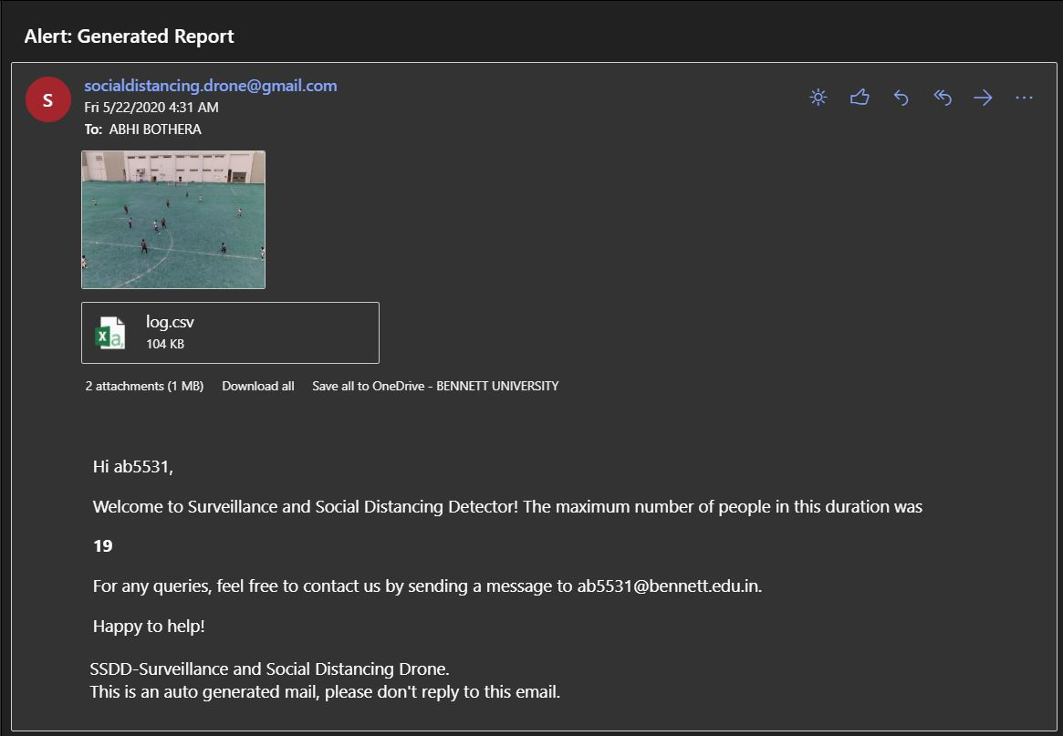
Alert to Authorities

Slide 8
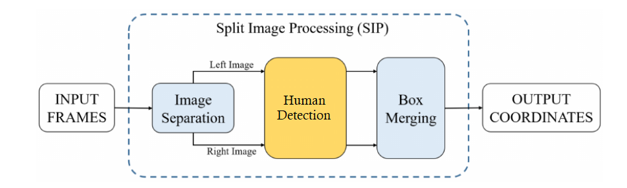
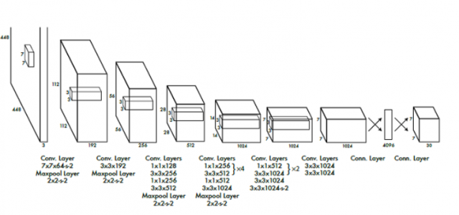
Methodology behind YOLO_v3
How does it work?

Slide 9
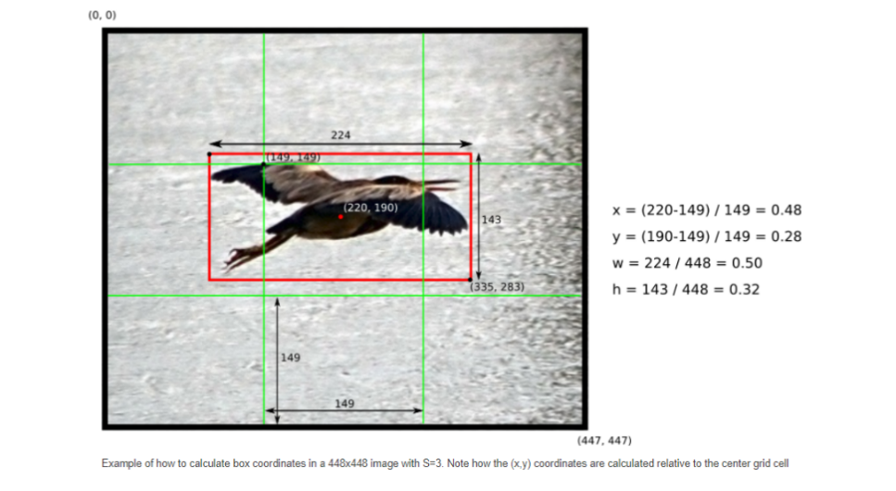
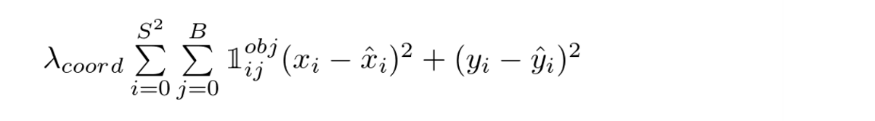
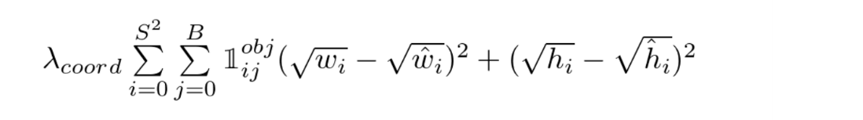
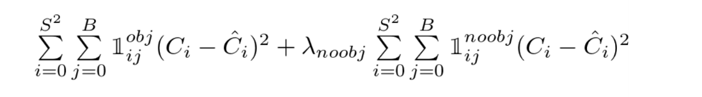
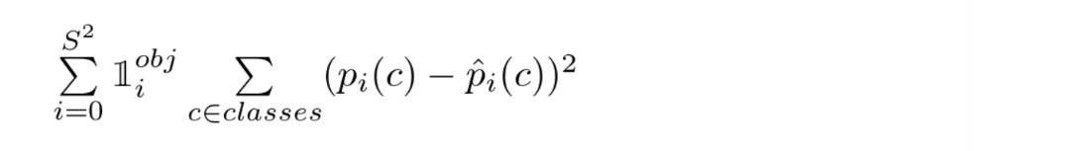
Formulas Used
How does it work?

Slide 10
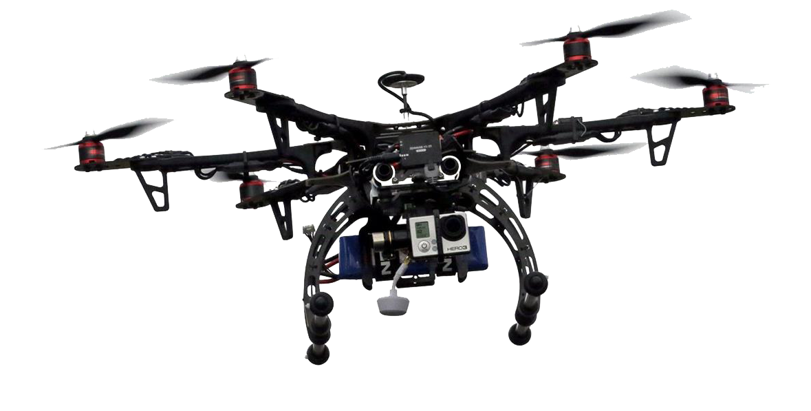
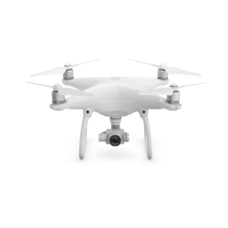
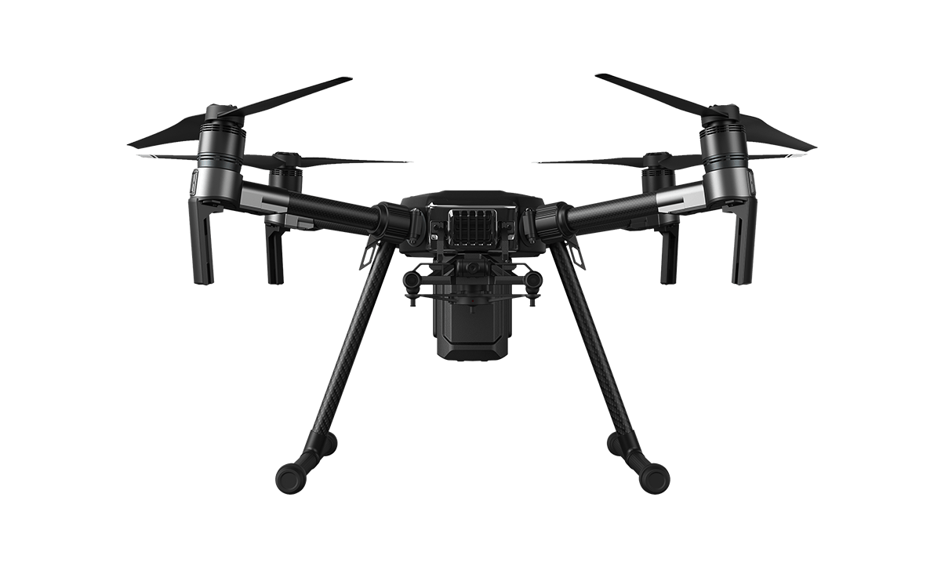
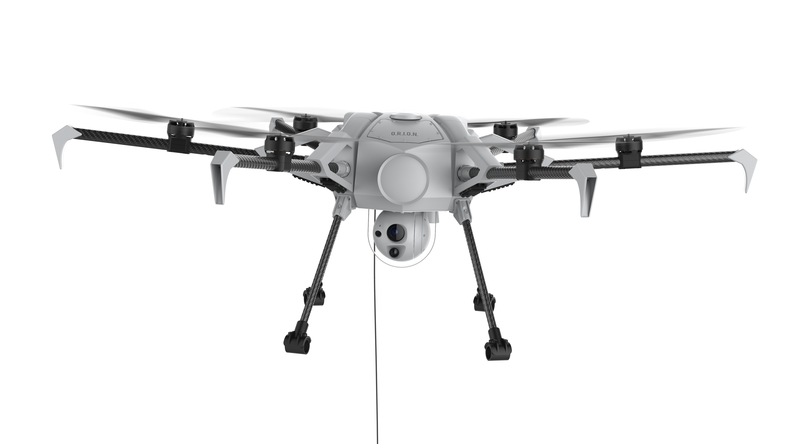
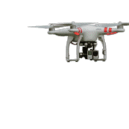
Thank You
By:
Abhi Bothera - E17CSE128
Mudit Kapoor - E17CSE147

